Slide 1
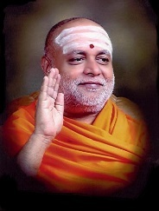

||Jai Sri Gurudev||
S J C INSTITUTE OF TECHNOLOGY
DEPARTMENT OF ELECTRONICS AND COMMUNICATION ENGINEERING
PROJECT PHASE-I FIRST REVIEW
OBJECT DETECTION AND IDENTIFICATION
Presented by:
ANNAVAJALA NIKETH SANDILYA USN-1SJ20EC010
KAMMARACHEDU NANDINI USN-1SJ20EC061
Under the guidance of
Shreehari H S
Assistant Professor
Dept. of ECE, SJCIT
Project coordinator
Ravi M
Assistant Professor
Dept. of ECE,SJCIT

Slide 2
OUTLINE
Introduction
Objective of the Project
Statement of the Problem
Methodology
Literature Survey
Block Diagram
Hardware and Software Requirements
Expected Outcomes
Plan Of Action & Execution
Applications
Advantages
References

Slide 3
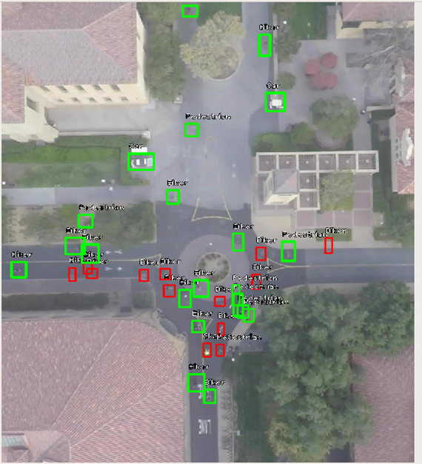
INTRODUCTION
Object detection is a computer vision technique that identifies and classifies a particular object in a particular setting.
The main goal of object detection is to scan digital images or real-life scenarios to locate instances of every object, separate them, and analyze their necessary features for real-time predictions.
Image of detection and identification

Slide 4
OBJECTIVE OF THE PROJECT
Create a system that can see and recognize everything in a video taken by an ESP32 cam on a flying robot.
Use the system to find safe places for flying robots to land and to identify important things in the video.
Take the features of important things in the video and compare them to a database of known objects to figure out what they are.
Change the system so that it can also be used to analyze traffic and find security threats by comparing old and new images to see what has changed.

Slide 5

STATEMENT OF THE PROBLEM
The current object detection and identification system for flying machines is not capable of functioning effectively in adverse weather conditions, such as low visibility, reliability in real-world scenarios.
To make system to identify the landing area.
Using GPS system to find its location, to get the required data form the system.

Slide 6
METHODOLOGY
Step-1: Take ESP32 with cam and connected with Arduino
Step-2: Using CAM in ESP32 and store in a memory card. And then data of video will be taken from memory card.
Step-3: Take entire system to top by using any fly machine like balloons or drone.
Step-4: Data collected will be processed by using OpenCV2 module and the features will be redrived and all required features will be extracted.
Step-5: Machine learning algorithms required data. Data of features of and there classification. We are using persons, mountains, rivers, buildings, cars and motor vehicles, trucks etc.
Step-6: As we will get the video with bounding box and labelled.

Slide 7
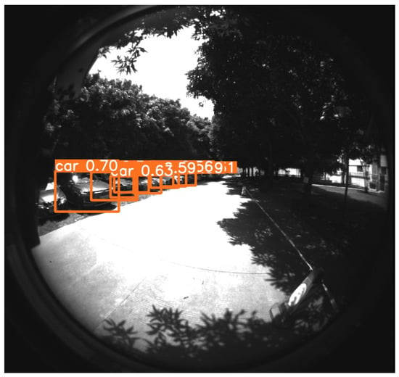
LITERATURE SURVEY
An intelligent real-time object detection system on drones et al.[Chao Chen]
In this paper, Drones have been widely used in everyday life and they can help deal with various tasks, including photography, searching, and surveillance. it is difficult for drones to perform customized online real-time object detection. In this study, we propose an intelligent real-time object detection system for drones. . By using the Yolov3-tiny model for fast object detection, our system can detect objects at the speed of 8 frames per second and achieves a much lower power consumption compared to state-of-the-art methods.
The ordinary car-detection result

Slide 8
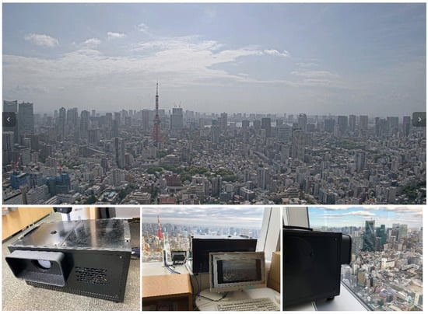
LITERATURE SURVEY
Sky Monitoring System for Flying Object Detection Using 4K Resolution Camera et al.[ Takehiro Kashiyama]
The use of drones and other unmanned aerial vehicles has expanded rapidly in recent years. These devices are expected to enter practical use in various fields, such as taking measurements through aerial photography and transporting small and lightweight objects. This study developed a monitoring system for flying objects using a 4K camera. We installed a monitoring system in a high-rise building in an urban area during this study and evaluated the precision with which it could detect flying objects at different distances under different weather conditions. The results obtained provide important information for determining the accuracy of monitoring systems with image processing in practice.

Slide 9
BLOCK DIAGRAM
MACHINE LEARNING MODEL
CREATING A BORDER BOX
CAMARA TAKES REAL TIME VIDEO
MEMORY CARD STORES THAT DATA
OBJECT LABELING
Camera-The camera captures real-time video of the flying machine's surroundings. The video is then transmitted to the memory card for storage and processing.
Memory Card-The memory card stores the real-time video captured by the camera. The video is then processed by the linear recursion machine learning model.
Linear Recursion Machine Learning Model-The linear recursion machine learning model is used to detect objects in the real-time video. The model has been trained on a dataset of images and labels, which allows it to identify and locate objects in new images.
Border Box Creation-Once an object has been detected, the system creates a border box around it. The border box indicates the location and size of the object in the image.
Object Labeling-The system then labels the object in the border box. The label indicates the type of object that has been detected.

Slide 10
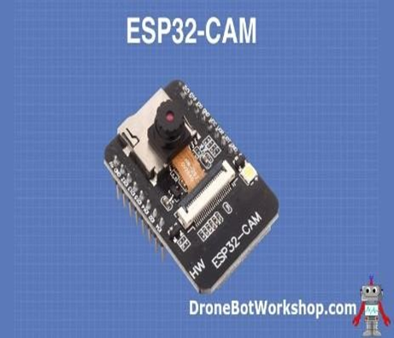
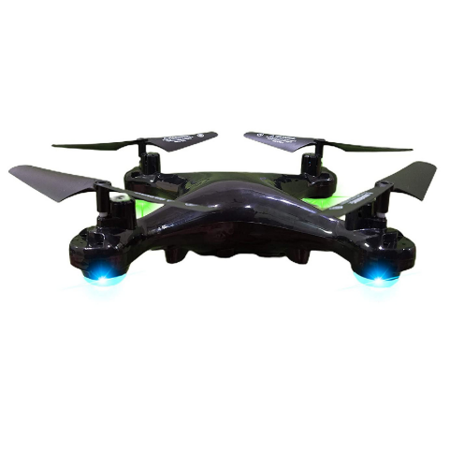
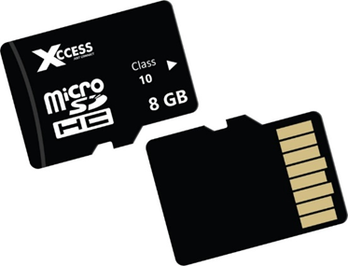
HARDWARE REQUIREMENTS
The hardware components that are used in the preparation of the quadcopter
ESP32-S
Memory card
Balloons
Own drone or Any flying object
Drone (or)Any Flying object
Memory card
ESP 32 CAM

Slide 11

SOFTWARE REQUIREMENTS
The software components that are used in the preparation of the quadcopter
Arduino
ESP-32 board configuration
Google collab
Data sets of images and their classification

Slide 12
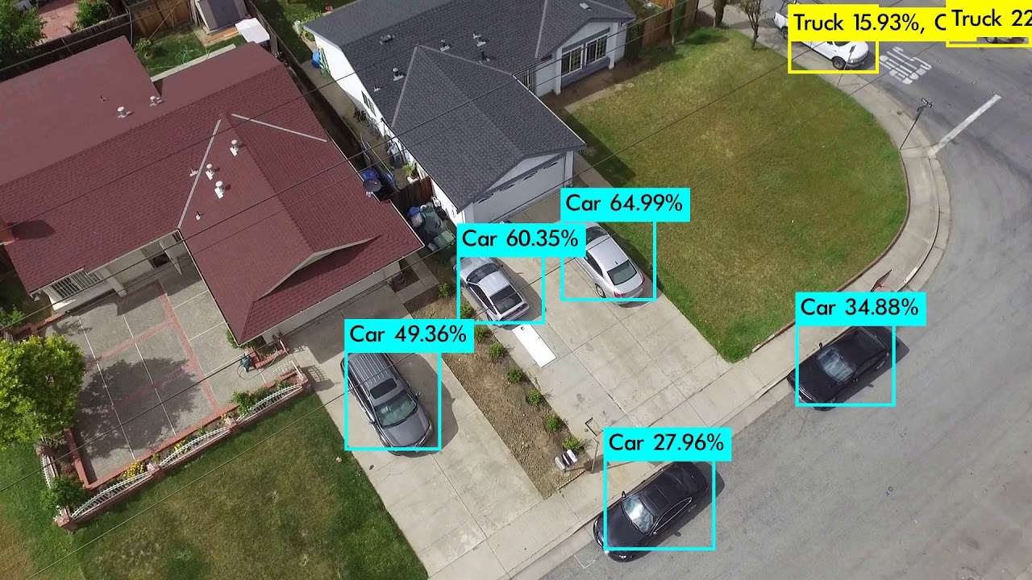
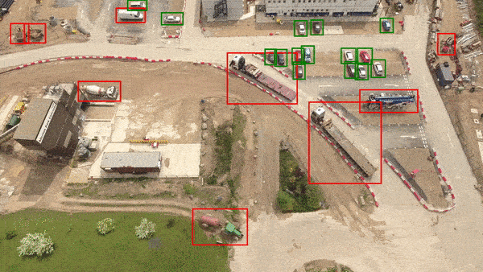
EXPECTED OUTCOMES
Accurate identification of objects in the flying machine’s path. Real time tracking and Monitoring of objects.

Slide 13

APPLICATIONS
In Security and surveillance
Environmental Monitoring
Traffic Management
planning and Infrastructure
Agriculture

Slide 14

ADVANTAGES
We Can detect a wide range of objects, including animals, vehicles, and other non-human entities.
Can detect multiple objects within a single image or video.
By detecting and avoiding obstacles in the environment, image object detectors can help ensure the safety of both the flying machine and the surrounding area.

Slide 15
REFERENCES
[1] Kashiyama T, Sobue H, Sekimoto Y. Sky Monitoring System for Flying Object Detection Using 4K Resolution Camera. Sensors (Basel). 2020 Dec 10;20(24):7071.doi.org/10.3390/s20247071. PMID: 33321798; PMCID: PMC7763826.[1]
[2] chao chen, yongkui yang An Intelligent Real-Time Object Detection System on Drones. ppl. Sci. 2022, 12(20), 10227;doi.org/10.3390/app122010227.[2]
[3]electronicsforu.com/electronics-projects/low-cost-drone-powered-by-esp32-cam/ accessed on 11/7/2023
[4] instructables.com/Arduino-micro-Quadcopter/ accessed on 11/7/2023
[5]researchgate.net/publication/357247011/figure/fig1/AS:1104177048621168@1640267 731913/Some-components-of-the-ESP32-CAM-camera-b-piezoelectric-sensor-and-c.jpg/ . Accessed on 11/7/2023

Slide 16
THANK YOU

